Slide 1
THEOLOGY OF THE BODY for Teens

Slide 2
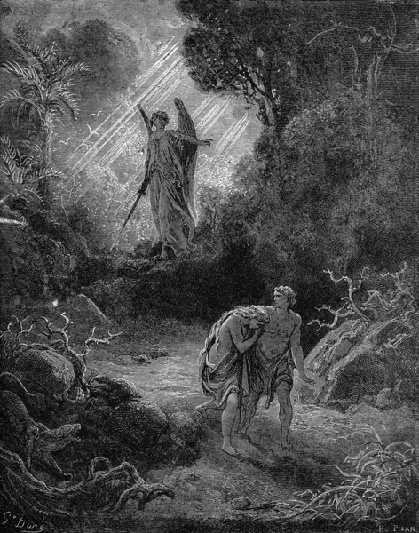
Chapter One
-Adam and Eve chose to disobey God. They committed the first sin. (Original Sin) Because of this, we have a tendency to sin. This is called concupiscence.
-Because of sexual liberation, people feel that they can choose to use their sexuality in any way they choose.
- We have become desensitized because of the way the media deals with sexuality (i.e.; frog in the pot, page 9).
-Lust is the disordered desire for inordinate enjoyment of sexual pleasure. It is pleasure at the expense of another. The other person is used as an object.

Slide 3
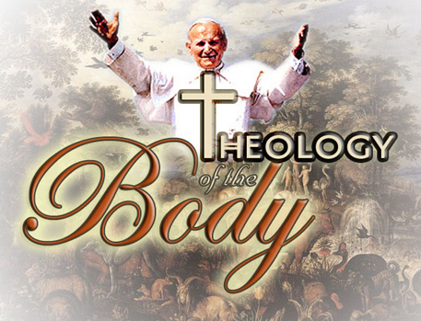
Theology of the Body
-John Paul II’s 129 weekly audience addresses where he outlined the Church’s teaching on sexuality.
-Our bodies and sexual desire show us the meaning of our existence.
-It demonstrates why we are here and our purpose.

Slide 4
Theology -The study of God. Theology of the body is the study of God revealed through our bodies.
-A communion of persons is formed when two or more persons give themselves to one another in love.
-God created humans to participate in heaven and on earth in God’s love.
-The total gift of self can be seen in marriage or celibate life (choosing to forego earthly marriage so as to devote oneself to the marriage of Christ and the Church.)

Slide 5
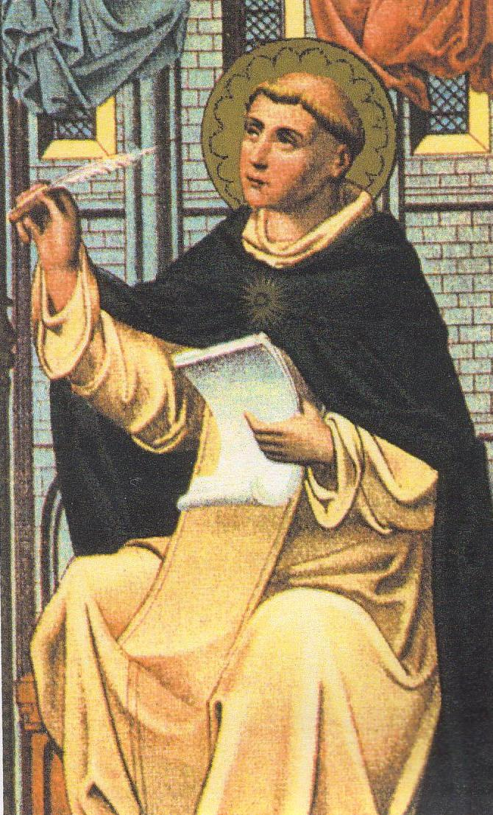
-Our main goal as humans is love – the decision to “will the good of another person” (St. Thomas Aquinas -- right).
-John Paul II’s vision of the body as the visible sign of that which is invisible.
-A sacrament makes a spiritual reality visible; the body makes our call to love visible. This is called the sacramentality of the body.
-Read “Digging Deeper” pages 12 -13.

Slide 6
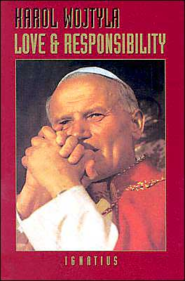
Chapter Two. Loved Defined : Giving vs. Using
Intro - “Hook Up World” pages 21 - 22.
Love - not merely a feeling. It is an act of will that consists of
preferring the good of others to the good of oneself.
- You can’t judge the value of love by the intensity of the emotion.
Love and Responsibility – a book by John Paul II that grew out of
a series of lectures that he gave from 1958 to 1959 as
Karol Wojtyla.
-He links love to the virtue of chastity – “chastity is the
sure way to happiness”.

Slide 7
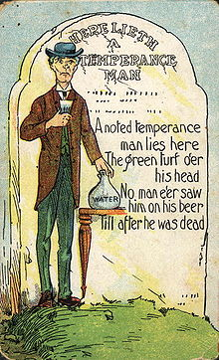
Chastity - the virtue that directs our sexual desires and activities
toward the truth of love.
-Says “yes” to the demands of love.
Virtue - the firm habit of doing what is good.
Abstinence - not having sex.
Temperance - the virtue of controlling and moderating our desire for pleasure.
Personalistic Norm - a term used by John Paul II to explain that human persons deserve only the best. We should never treat anyone with less than love.

Slide 8
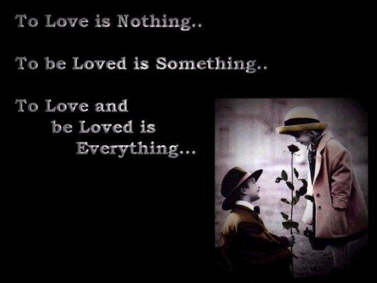
John Paul II described the three aspects of love.
(a) love as attraction – recognizing the good of another person; seeing the inner beauty of another person.
(b) love as desire – wanting a good for yourself; desiring goodness and happiness.
(c) love as goodwill - willing (or desiring) the good of another person. We also call this type of love agape. Loving vs. Using
-Hate is not the opposite of love. Using is the opposite of love.
Utilitarianism – using others for one’s own gain.

Slide 9
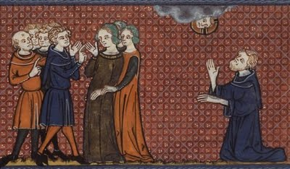
Chapter Three. Naked Without Shame
Intro : The Two Bishops
Original Sin - the first human offense against God.
Original Man - the period of humanity before their first sin.
Original Solitude - Adam’s experience with the animals without Eve.
Adam realizes he is alone.
Original Nakedness - the peaceful state where Adam and Eve were naked
without shame. Lust does not exist, and desire was pure.
Original Innocence - prior to the first sin, the hearts, mind, and bodies are perfectly innocent.

Slide 10
Nuptial Meaning of the Body - our bodies reveal its own meaning
in which it becomes a gift.
Original Unity - the initial experience of perfect unity as they live in
communion with each other.
God’s love can be described as:
Free - given to us without limit.
Total - God’s love is complete, and He gives all to us.
Faithful - God never abandons us and never stops loving us.
Fruitful - God’s love brings us life. Jesus died for us, so that
we could have new life.
Historical Man - period that begins with original sin and ends when Christ returns.

Slide 11
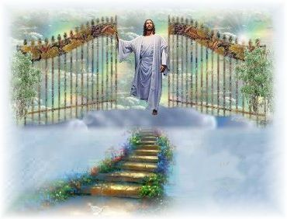
Chapter Four. Hope and Redemption in Christ
God desires us to be with Him in heaven. Jesus is our invitation and ticket to enter His kingdom. By His sacrifice, we may enjoy a union with Him in heaven – the marriage of perfect love between Christ and His Church.
Eschatological Man - is the final stage of perfection achieved in the
Resurrection at the end of time where we will be freed
from any tensions between the flesh and spirit.
Read page 52 “The Room”.
Because of our tendency to sin, God gives us help to overcome it. He
sends His Son to redeem us (our bodies and our desires).

Slide 12
In eternity, we will experience the fullness of Christ’s redemption; and when we are rejoined with our bodies, they will be our glorified bodies.
The nuptial meaning of the body not only points toward our union on earth, but to our heavenly marriage.
-Eschatological man will be married, but not on earth. We will be married as members of the Church, the bride of Christ.
-There will not be physical, sexual relationships in heaven, but we will retain our gender (a difference between the sexes).
-Preparation for this marriage begins now. Courtship is a time to get to know the person you will marry. Our earthly life allows us to learn about Jesus.

Slide 13
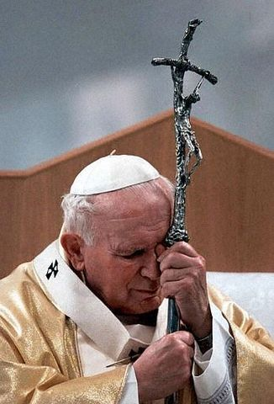
“The hope of every day” - according to John Paul II, is that Jesus offers us grace
to begin anew now and allows us to enter communion with Him in heaven.

Slide 14
Chapter Five. Truth and Freedom
Freedom - the ability and desire to choose the good and accept the
responsibilities of authentic love.
-Real freedom is experienced when we remember who we are and how we are called to live.
Read “Free and Empty “ pages 68 and 69.
In order to understand freedom, we need to find the objective truth (a reality
that cannot be changed ourselves) vs. subjective truth (someone’s opinion).
We must deal with internal constraints (distractions or disordered desires within us that steer us away from choosing the good) or external constraints (the laws of God or society that protect us from abusing our free will and hurting ourselves or others).

Slide 15
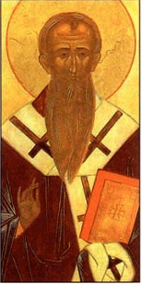
God gives us the gift of free will - it allows us to choose between
good and evil. We choose our own destiny.
St. Irenaeus - “Man is rational and therefore like God; he is created with free will and is master over his acts.”

Slide 16
Chapter Six. Language of the Body
Read “A Deceptive Appetite” pages 82 and 83.
John Paul II taught that the language of the body is not only a language of love, but a language of divine love.
Our body makes a promise to another during sex. It requires the total commitment of marriage. The language of sex is only true when it speaks of marital love.
Sex makes a gift of one person to another.
Lies of the body include: fornication, contraception, and pornography.
Fornication - is sex outside of marriage. The “hooking up” culture gives no promise of a long commitment.

Slide 17
Contraception - every action before, during, or after sexual intercourse that impedes the procreative potential. Contraception says
“I refuse to give you all of myself. I won’t give you my fertility”.
Contraception - is a barrier between a couple’s full love and gifts of self.
Pornography - the sexually explicit depiction of persons, in words or images, created in order to cause the arousal of lust on the part of the observer.
-No self-giving in pornography.
-The body is separated from the person.
-Makes us enter the world of lust and fantasy.
Page 91. Live It Out : Overcoming Lust.

Slide 18
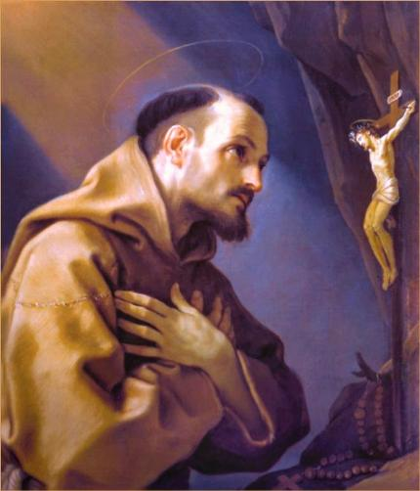
Living a pure life.
(1) Remove the temptation.
(2) Frequent the sacraments.
(3) Keep busy. St. Francis said, “Always be doing something worthwhile; then, the devil will always find you busy”.
(4) Pray for the redemption of your desires.

Slide 19
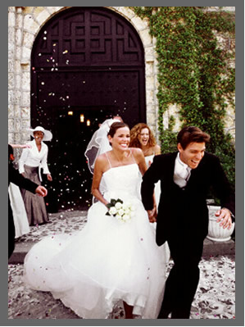
Chapter Seven -- Free, Total, Fruitful, and Faithful

Slide 20
Spousal Vows of Love vs. Christ’s Example of This Love
-Will you accept children lovingly from God and bring them up according to the laws of Christ?
-Have you come here freely to give yourselves in marriage?
-Will you love and honor each other as man and wife for the rest of your lives?
-Have you come here without reservation (withholding nothing)?
“I came that they might have life and have it more abundantly.”
“I lay down My life. . .No one takes it from Me.”
“I am with you always until the close of the age.”
“Greater love has no man than this, that a
man lay down his life for his friends.”

Slide 21
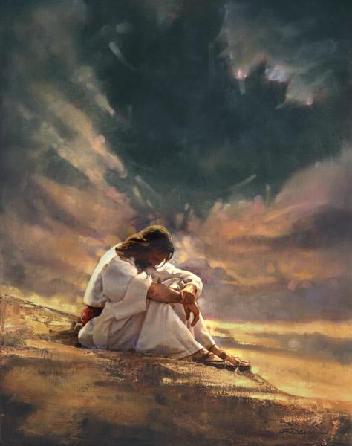
Free - Jesus modeled for us, through His passion and death, what free love really means.
Total - As Jesus gave us all that He had, He shows us what total love really looks like.
Faithful - Jesus was faithful to His Father’s will and faithful to each one of us.
Fruitful - There was never a more fruitful life and death than that of Jesus Christ.
His death bring new life to humanity.
Understanding Homosexuality
Natural law - governs the behavior of man and written into the very nature of every human being.

Slide 22
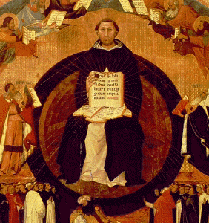
Natural law helps us to look at the body and see that it was created for certain functions.
The natural design of the body demonstrates its love giving and life-giving purpose.
Our sexual organs do not have the same clear purpose when matched up with a person of the same sex.

Slide 23
Chapter 8-Marriage
Page 112 &113-The story David and Brenda
Pope John Paul II insisted that the spousal analogy of Christ's love for the Church is the only key to understanding the Sacramentality of marriage.
Marriage is an amazing opportunity for spouses to image agape love (God’s unconditional love) for each other through mutual respect and total self donation.
John Paul II called marriage the “primordial Sacrament” or the first sacrament.
Too many relationships are built on infatuation. This fades where some stress of suffering comes along, you are left with the real person that you have chosen to marry. At this point, love is tested, and its value comes to light.
Pope John Paul II says at this point if a couple's love is a true gift to self, it will not only survive but grow stronger and sink deeper roots.

Slide 24
Humanae Vitae -- Pope Paul VI’s encyclical on the Church’s teaching on procreation and the meaning and purpose of the sexual gift.
In this encyclical, he offered reasons for the immorality of contraception and predicted what would take place if it were to become common in society. He warned about the increase in marital infidelity and a general lowering of the morality of the youth.
The pope had witnessed the acceptance of contraception within Christianity (the Anglican faith) and knew society would soon also accept it. Many leaders in society including Gandhi and the early feminist leaders had also warned of the negative consequences of contraception.
The Church urges the use of Natural Family Planning (referring to the various effective, natural, and moral methods for achieving or postponing pregnancy.)

Slide 25
Oxytocin= a hormone released in the pituitary gland of the brain during childbirth, breast-feeding and in intercourse, causing emotional bonding between persons in whom it is released. This chemical offers proof that men and women are physically created to be in mutually exclusive relationships.

Slide 26
Chapter 9- Celibacy and Religious life
Celibacy is a special vocation to which God calls on people to live as their way to holiness.
God calls every human being to live out their lives through their vocation or special calling.
Celibacy is a free choice to renounce marital communion with a spouse in order to serve God and the Church more fully. The Church forces no one to be celibate. In the case of the priesthood, the Church chooses her priests from among the men who have discerned and freely chosen celibacy as their life’s location.
Celibacy does not reject sexuality. Those who enter the religious life as priests, brothers, sisters, etc. are a foreshadowing of how all of us will live in the heavenly kingdom. Celibacy is a witness to the fact that there is a greater joy (that is heaven) than the joys of this world. It shows the true meaning of our sexuality, the giving of ourselves to God.

Slide 27
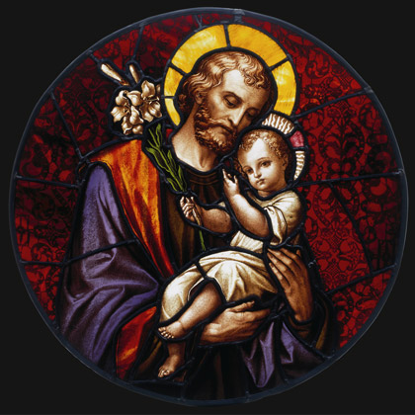
St. Joseph, the most chaste spouse of the Blessed Virgin Mary, was so enraptured by the love of God that no earthly love could possibly compare. His chastity allowed him to more perfectly get himself to God.
Men and the priesthood-
1. The priest acts in persona Christi, as they provide us with the sacraments and other ecclesiological services.
2. Since God created marriage as the union between a man and a woman, only a man can act in the person of Christ as a groom who was meant to marry his bride, the Church.
3. The priesthood is a spiritual fatherhood.

Slide 28
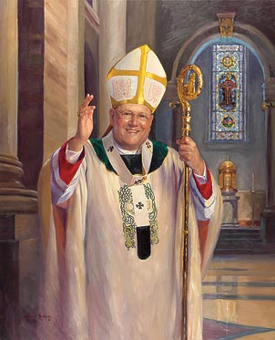
Why aren't priests married?
1. Since the priest acts in persona Christi and marries the Bride of Christ, the Church, he should give himself completely to her.
2. The Church teaches that celibacy is an objectively higher calling than marriage, because it more directly reflects the heavenly marriage of the Church and the Lamb of God.
Celibacy is considered to be an eschatological sign because it foreshadows what heaven will be like.

Slide 29
Chapter 10-Finding Your Vocation.
Some obstacles to finding God-
1. Our lives are too noisy. We wake up to music, watch television, listen to the radio and never give ourselves a chance to be still and quiet in prayer. As John Paul II said, “Above all, create silence in your interior. Let that ardent desire to see God rise from the depths of your hearts, a desire that at times is suffocated by the noise of the world and the seduction of pleasures.”
2. We are too busy. We seldom leave room to pray. Like any good relationship, our relationship with God will deepen according to how much effort we put into it.
3. Lack of trust. We don’t trust God. We don't trust others. We're afraid to hear what God has to say to us. He might be asking us to do something or let go of something that is very difficult.
4. Apathy. Sometimes we don't seem to care what God has to say. We put faith on the back burner and contemplate this relationship it only in times of trouble and difficulty.
5. Blurry vision. Society and an obscured morality make it difficult for us to see things clearly. We let our sins and a corrupt world point us in the wrong direction.

Slide 30
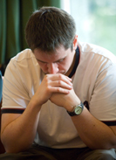
Finding the right path in life.
1. Pray. Spend time getting to know and love God through prayer, the sacraments, etc.
2. Ask yourself if your decisions are in line with what God teaches and what He wants of you.
3. Give advice. Seek the wisdom of those smarter than you, have lived life and understand the correct path to choose.
4. Practice reconciliation. Seek forgiveness in your own life and do not be afraid to forgive others.
5. Listen to your heart. God often speaks to us through a conscience and through our intuition.

Slide 31
Chapter 11 – Dating with Purity and Purpose.
The purpose of dating.
1. The ultimate purpose of dating is to find a spouse.
2. To discover the qualities that we like in other people.
The basis of every relationship with the opposite sex should be friendship. Too many relationships today are built on sexual attraction and provide a weak foundation for a true relationship.
Courting teaches you to be friends with a particular person before jumping into a romantic relationship.

Slide 32
Some practical advice for dating.
1. Avoid impure relationships before they begin. Stay away from the hooking up mentality that treats the relationships with the opposite sex is pure recreation.
2. Know your boundaries before you attempted to make sure your date knows them as well.
3. Choose friends who elevate you morally rather than drag you down.
4. Avoid impure images, music, magazines that corrupt you morally.
5. Think about your future and the man or woman who you want to be with for the rest of your life. Think about the consequences of your actions and how they might affect your marriage someday.

